Slide 1

Welcome to
Year 2

Slide 2
Introductions
Teacher – Miss Baxter
Teaching Assistant – Mrs Soulsby
Working together with you to help your child to learn and grow!

Slide 3
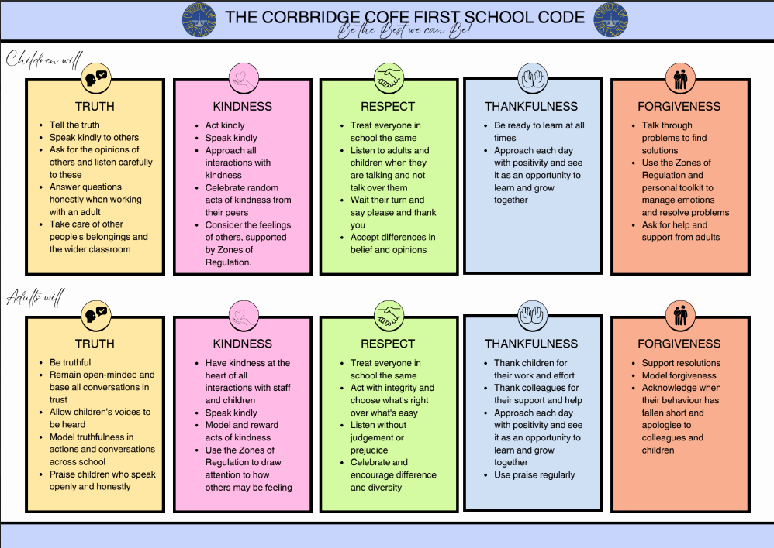

Slide 4
Things to remember:
Named water bottle
Named uniform
PE – will be held on a Monday and Tuesday. On these days your child is to come to school wearing their PE kit. As much of our PE as possible will be outdoors so please make sure your child is dressed appropriately and has the correct kit at all times.
No jewellery to be worn
Long hair should be tied up
Remember to send some wellies into school so we can go on the grass in all weathers.
Medical forms – updated if necessary (asthma, allergies etc.)

Slide 5
Rewards
We focus on promoting positive behaviour for learning and want to recognise all of the fantastic things the children do. The following are the reward systems we use in class.
Daily:
House points
Stickers
Weekly:
Friday Celebration Assembly:
  Golden book
  Stars of the week
  House point winner
  Wellbeing time

Slide 6
Reading
We love to read and promoting a love of reading is at the heart of our school, it underpins so many areas of learning and helps all children to access and develop so many other skills. We want to work closely with all of our families to ensure this continues at home. We want all of our children to engage and experience a wide range of texts including fiction, non fiction, newspapers, magazines, e-books etc.
Individual books changed once a week and recorded in their reading journal – these books will be sent home on a Wednesday and should be returned to school the following Monday.
Encourage daily reading of a range of texts. Reading should be recorded daily in the reading record at home.
The homework book is also used as a reading scrapbook this year; use this to show any book reviews, drawings, pictures, trips or anything else they may have done related to the books they have been reading.
Please support your child to read every night. Whilst many children are confident readers already, reading aloud is an important skill to practise as well as sharing books and stories, discussing characters, plots and facts are all important parts of developing a good understanding of reading as well as the technical skills, not to mention sharing books together is a lovely thing to do. Don't forget to read to your child too, this helps to model expression and listening to others reading is also a really fun and useful thing to do.

Slide 7
Homework
All homework will be sent out on a Wednesday and we would like it back in school on the following Monday.
The children will receive a weekly maths activity in their orange homework book linked to our area of learning in school – this will help to support and secure their mathematics knowledge.
Each half term an optional topic homework grid will be found in their orange homework book. These tasks are linked to the topic we will be covering in school and the children can receive house points for completing any of the additional homework they bring to school.

Slide 8
Spelling
Spellings will be sent home on a Friday and should be returned the following Friday, ready for a weekly spelling test.
Year 2 common exception words are attached in their homework books and on the website, for you to see and use at your convenience.

Slide 9
School Website
The school website will have a class page allocated to Year 2. The school website is a great place to find out about:
Diary dates, calendar
Year 2 page including Curriculum overview
Curriculum booklets
Photos
Newsletters
Policies
Staff and Governor information

Slide 10
Key Information:
Book bags to be brought in on a Monday and will be sent back home on a Wednesday.
Come to school wearing PE kits on Monday and Tuesday.
Named school uniform; including shoes and PE trainers.
Remember wellies to go on the grass.
Hand letters directly to a member of staff at the door.
Coats for all weather.
No toys to be brought into school.
Named water bottles.

Slide 11
Year 2
I can fully imagine you cannot believe we are in Year 2 already. The time certainly flies and they grow up so fast. It is really important to us that we support all of the children in class to develop and grow positively.
We don’t just want to do this academically (although that is of course immensely important to us), but also emotionally and socially. We hope that this year will be creative and exciting for all children as they immerse themselves in new and practical experiences. We will develop our self confidence and ability to face new situations with boldness and excitement.
In year 2 we want to create learning experiences which are fun, active, imaginative, challenging and inspiring which incorporate a wide range of practical, outdoor, creative, play-based, online learning styles.
It is going to be an amazing year and I am incredibly thrilled to have the opportunity to work with such a wonderful class.
Miss Baxter
Any questions/queries please don’t hesitate to ask I will be outside from 8:40am everyday.

