Slide 1
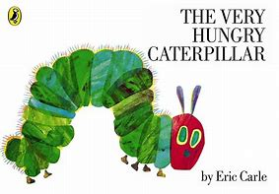
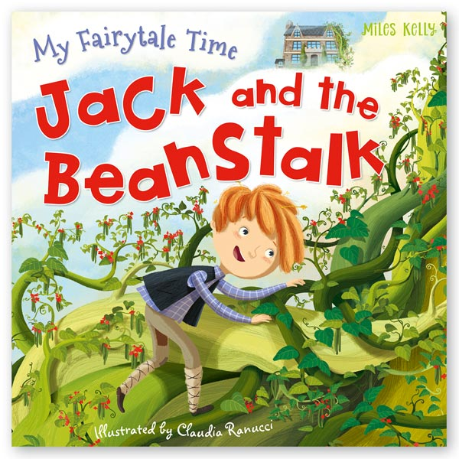
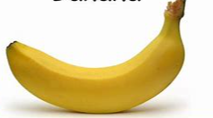
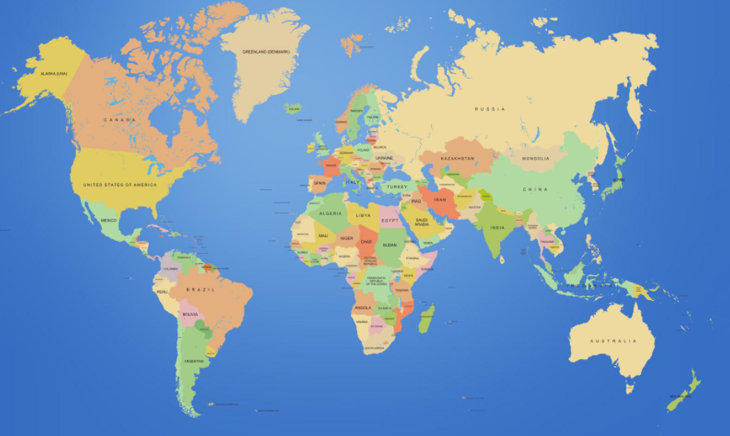
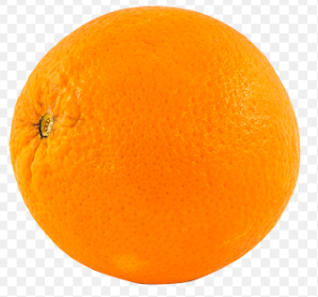
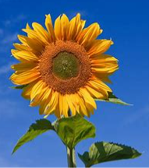
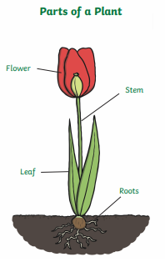
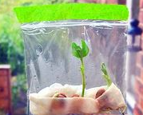
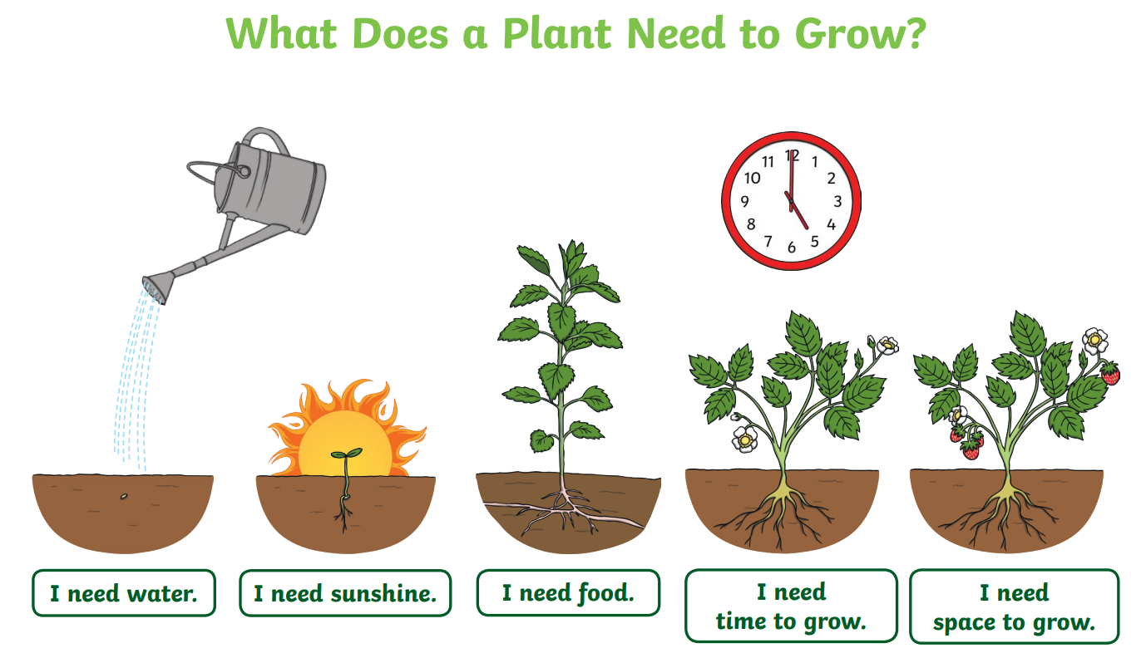
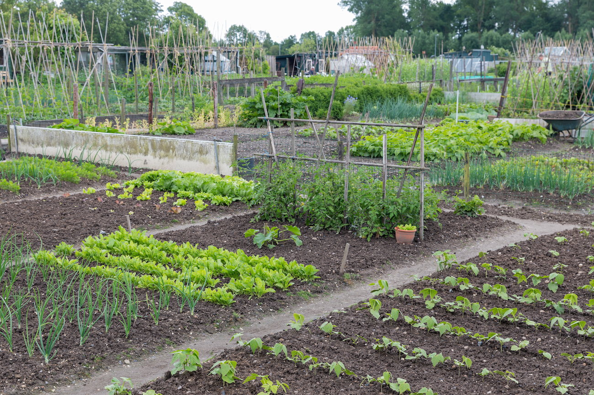
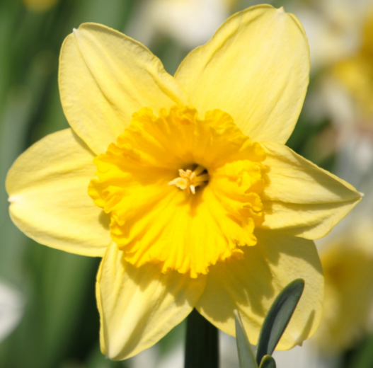
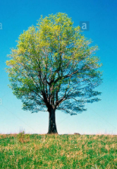
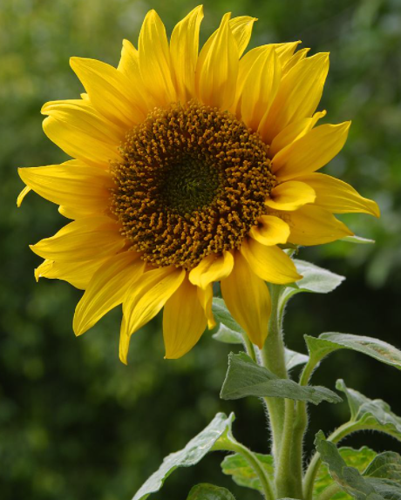
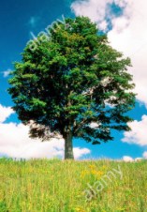
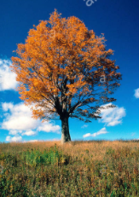
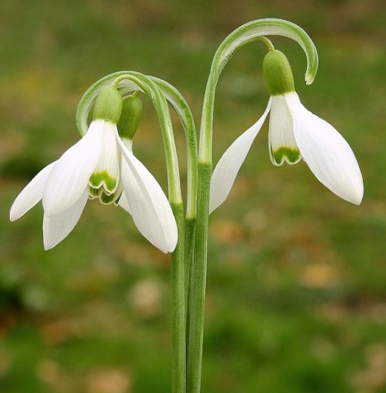
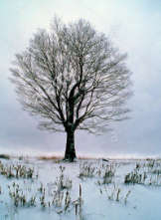
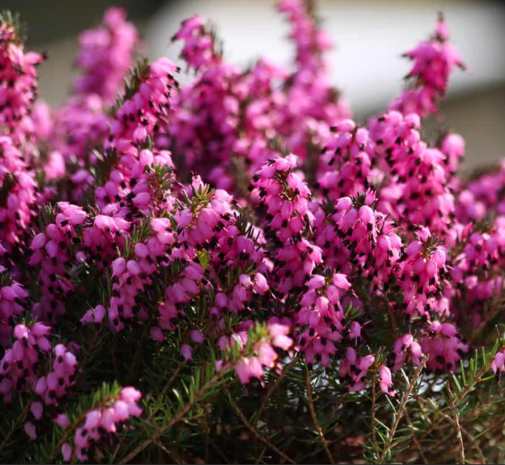
Nursery: Summer 1: Growing
We will be using our
curiosity, attention and
friendship character
muscles.
Enquiry question: Do all animals stay the same throughout their life?
Key Books this term:
Enquiry question: What do plants need to grow?
Grow your own sunflower competition!
Can you use the words taller and shorter to describe your sunflower?
What can you grow in your garden? Take some photos or bring in what you have grown.
Handa’s Surprise
Possible learning experiences:
Healthy fruits and vegetables
Farm to fork - where does our food come from?
Plotting our fruit on a map of the world.
Handas Suprise | Eileen Browne | Read along | bedtime story | picture book | - YouTube
The Very Hungry Caterpillar
Possible learning experiences:
Days of the week
Lifecycle of a caterpillar
Which food can we grow?
What are the life cycles of other animals?
The Tiny Seed / Jack and the Beanstalk
Possible learning experiences:
The needs of a plant experiment
Growing plants / flowers: sunflower competition, growing a bean and recording what we observe..
Drawing plants and flowers.
The Tiny Seed by Eric Carle || An INSPIRING Adventure! [CC] – YouTube
Jack and the Beanstalk Fairy Tale by Oxbridge Baby - YouTube
Growing vocabulary:
plant seed soil compost
grow bigger smaller shorter taller
We will visit our allotment to harvest vegetables and grow some food in our nursery planters. We sowed onions, lettuces and broad beans before the half term so we will continue to care for them and observe the changes.
Decay: What happens to food when it is left over time? Take photos and talk about what happens.
I'm a little bean - YouTube
roots: suck up nutrients from the soil
leaves: catch the sunlight to give the plant energy to grow
stem: the skeleton of the plant – helps it to stand tall and grow towards the sun
petal: the bright colour help to attract lots of insects
New life on the farm. A visit to a local farm to see new animals and how they will grow.
Spring | Summer | Autumn | Winter

Slide 2
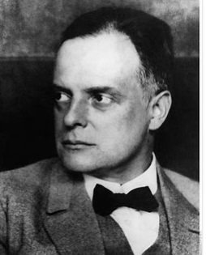
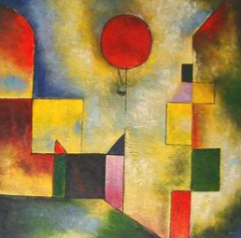
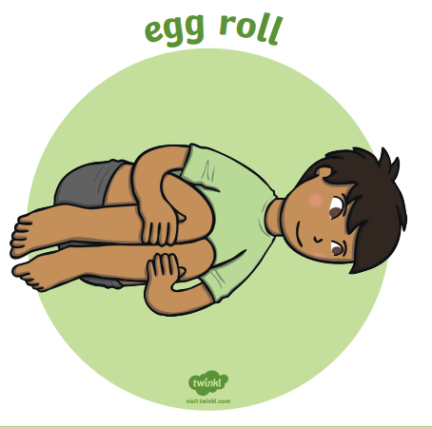
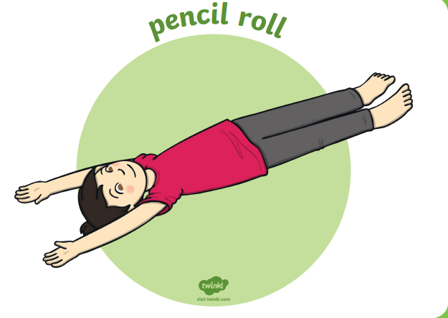
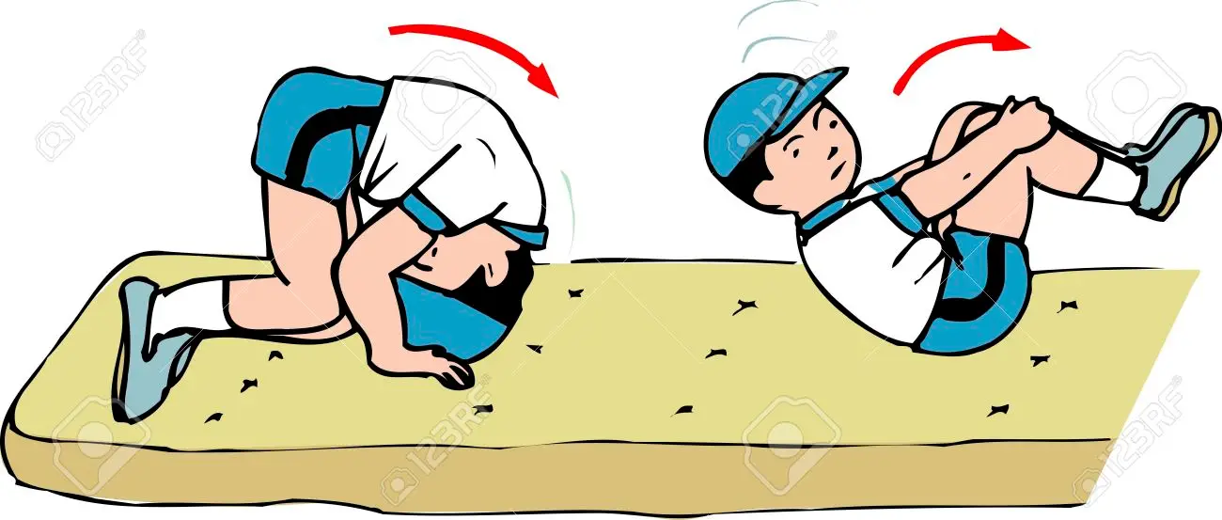
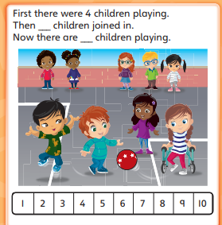
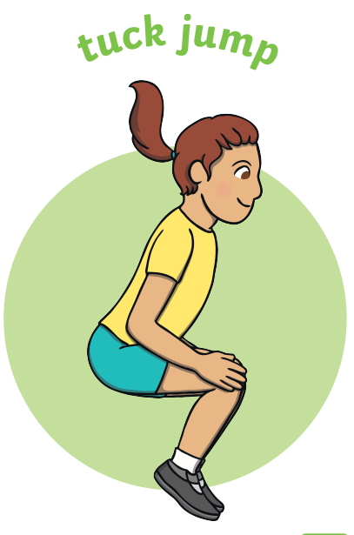
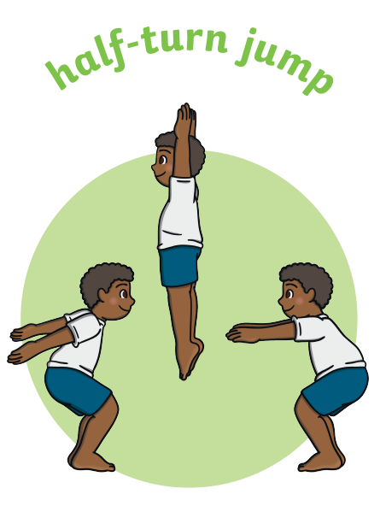
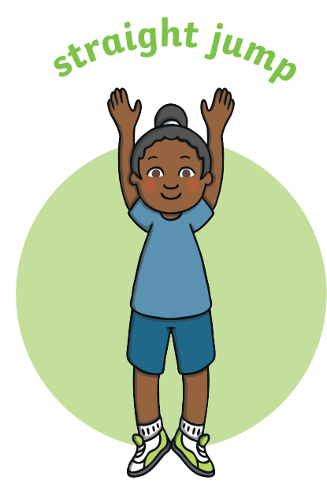
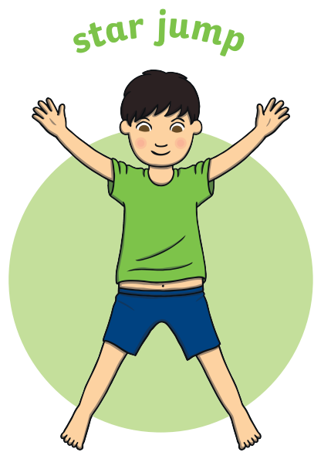
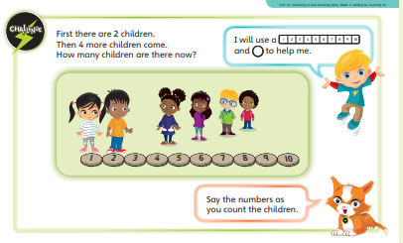
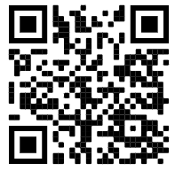
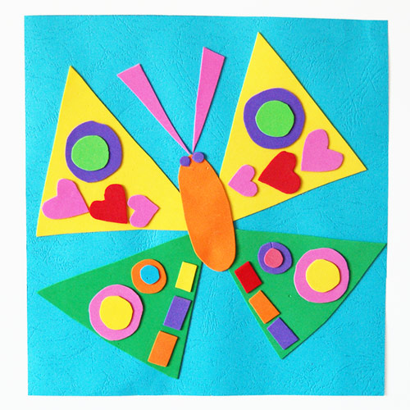
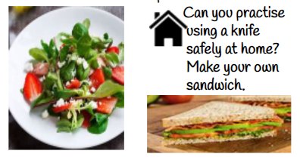
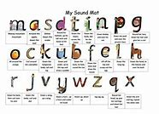
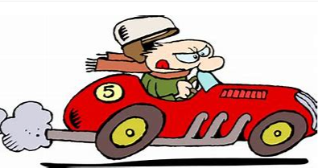
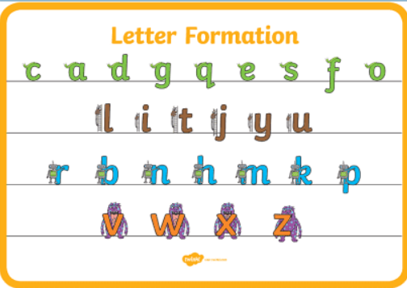
Physical Development: Gross and Fine motor Skill
Handwriting - Develop the foundations of a handwriting style which is fast, accurate and efficient.
Physical Development - PE: Gymnastics
I can confidently and safely use a range of large and small apparatus indoors and outside and in a group.
Mathematics: Number: Counting on and counting back
The children will explore addition and subtraction through counting on. Children will use a number track to practise counting the number of jumps required to move on or rather than the actual numbers they are landing on.
Number song 1-20 for children | Counting numbers | The Singing Walrus – YouTube
Play ‘I count you count’. Begin by pointing to yourself as you start counting. Then point to your
child and they continue 1 2 3 4 5 6 7 8 9 10 11 12 13 14 15 16 and so on.
Maths: Shape: the focus is for the children to learn the days of the week and sequence them correctly, using The Very Hungry Caterpillar and our days of the week song for support..
Expressive Arts and Design:
Artist: Paul Klee: 2D shapes painting and printing
Painting: Shades of colour / paint mixing
Printing repeated patterns with fruit and vegetables
Music: Technology: To explore and change sounds and music through play and technology.
To comment and respond to recordings of own voice, other classroom sounds.
To create music and suggest symbols to represent the sounds.
forward roll
These are examples of counting on tasks we will be doing.
(Jumping Jack)
Can you draw a hop scotch and practising counting on from any number?
Each week on google classrooms we will link you to a new movement to practise at home.
Jigsaw Healthy Me: Physical health and fitness / healthy eating. We will be talking about our favourite sports, healthy foods and why sleep is important.
Linking to maths, we will use shapes to create our own Paul Klee works of art.
Using tools to create a healthy salad: We will be learning how to safely use tools to make a salad.
=
Literacy: Reading
Correctly sequence a story or event using pictures and/or captions.
Respond to questions about how and why something is happening.
Know the difference between different types of texts (fiction, nonfiction, poetry)
Literacy: Writing
Orally compose and write a simple CVC word, e.g. t-o-p..
The car was in a rush.
Continue to learn Phase 1 sounds
Practice writing our names, with and without a name card for support.
Practice writing our phonic sounds.
Oral Segmenting - this is when you split a word up into its individual sounds (c-a-t). We call this ‘robot talk’.
Orally compose (say) a phrase /sentence.
Count how many words. Are in the phrase/ sentence and begin to ‘hold a sentence’ by adding a word to each finger.
Say first word for an adult to write it down.
Form most lower-case letters correctly, starting and finishing in the right place, going the right way round and correctly orientated. Include spaces between words.
Using our phonics to help us read:
Continue to apply knowledge of blending and segmenting to reading cvc words.
‘We look at the letters, make the sounds and blend the sounds together’ OR if it’s a superpower word ‘We see the word and say the word@
Oral blending - this is when you blend the sounds together to say the word (cat). We use a blending arm motion from left to right to help blend the sounds together.
Can you draw a picture of a flower you can see growing at home? Can you tell your adult the different parts of the plant?
Digraph: two letters that make one sound.
Can you practice writing your name?

