Slide 1
Life Cycles

Slide 2
LO’s
Can you explain the life cycle of a frog?
Can you notice that animals including humans have offspring which grow in to adults?

Slide 3
What is a life cycle?
Life cycle means the stages a living thing goes through during its life.

Slide 4
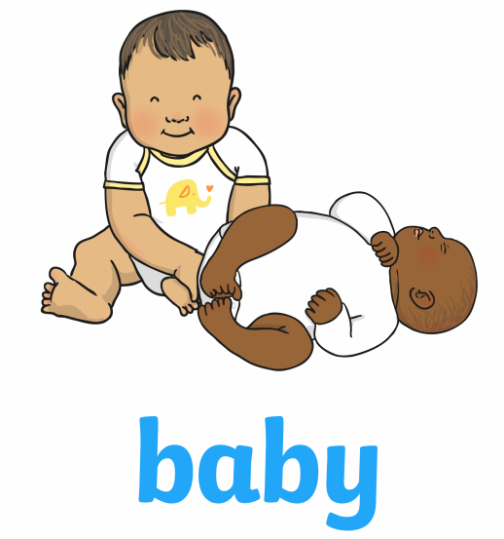
Human Life Cycle

Slide 5
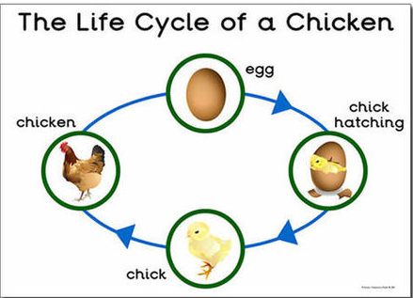

Slide 7
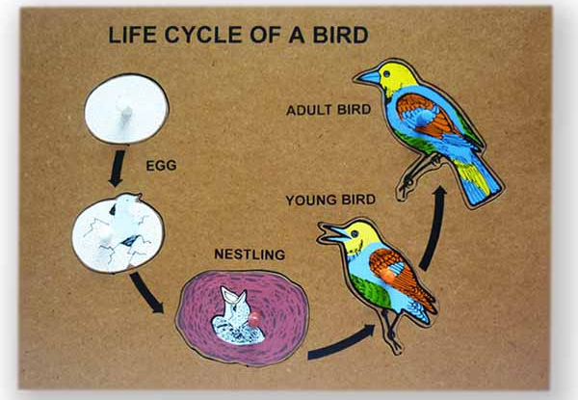

Slide 8
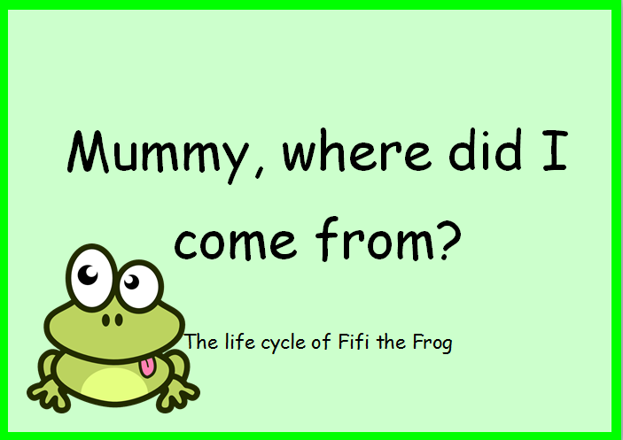

Slide 19
https://www.theschoolrun.com/what-is-a-life-cycle

