Slide 1
Tapestry information session
Why we use Tapestry
How to access your account
Commenting on staff observations
Group observations
How to add photos/videos

Slide 2
Why we use Tapestry
Assess children’s progress through observations
Photos, videos, comments, long observations
Can track children’s interests, trends in play, set enhancements, next steps for learning
Assessments are ongoing
Staff will endeavour to publish one observation weekly for you to access
Encourage observations from other sources; PE specialists, other childcare settings, parents.

Slide 3
How to access your account
Via website www.tapestryjournal.com
Download the tapestry app
Please change the password you have been allocated ASAP
Don’t share your log in details with anyone else
Any problems see Mrs Hutchinson – please be patient as I have to wait for Tapestry helpdesk to get back to me.

Slide 4
Commenting on staff observations
Staff to publish one observation per week (this will be reviewed throughout the year)
Nursery and Reception will publish an observation on one area of learning per week ~ staff constantly observe/assess all areas of learning
Feel free to comment on an observation but staff will not comment back
Staff will like a comment to acknowledge receipt
Commenting on observations isn’t designed to replace face to face dialogue!

Slide 5
Group observations
Sometimes observations will take place during group activities, co-operative play
Each observation/information shared will be personal to your child
Other children’s photos may appear
Do not download photos that show other children
Age band refinements attached to observations won’t always reflect the overall judgement of all children included in the observation

Slide 6
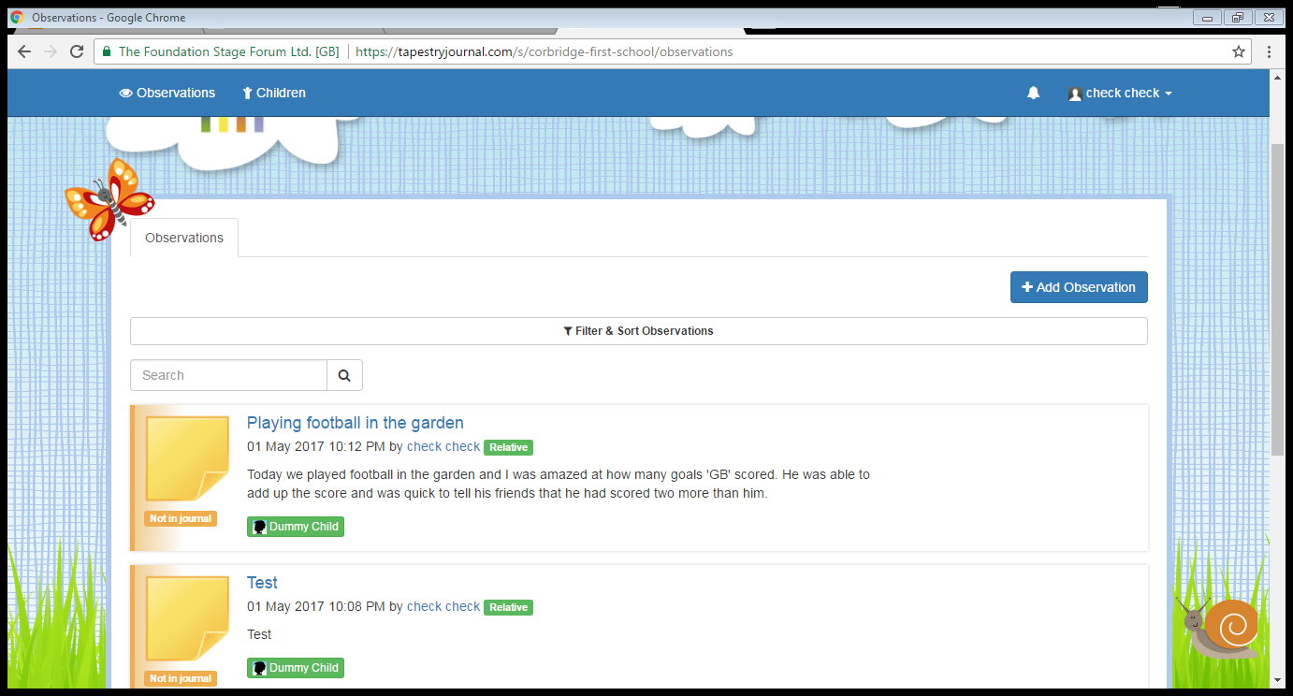
1. Begin by selecting add observation in the top right corner of your screen.

Slide 7
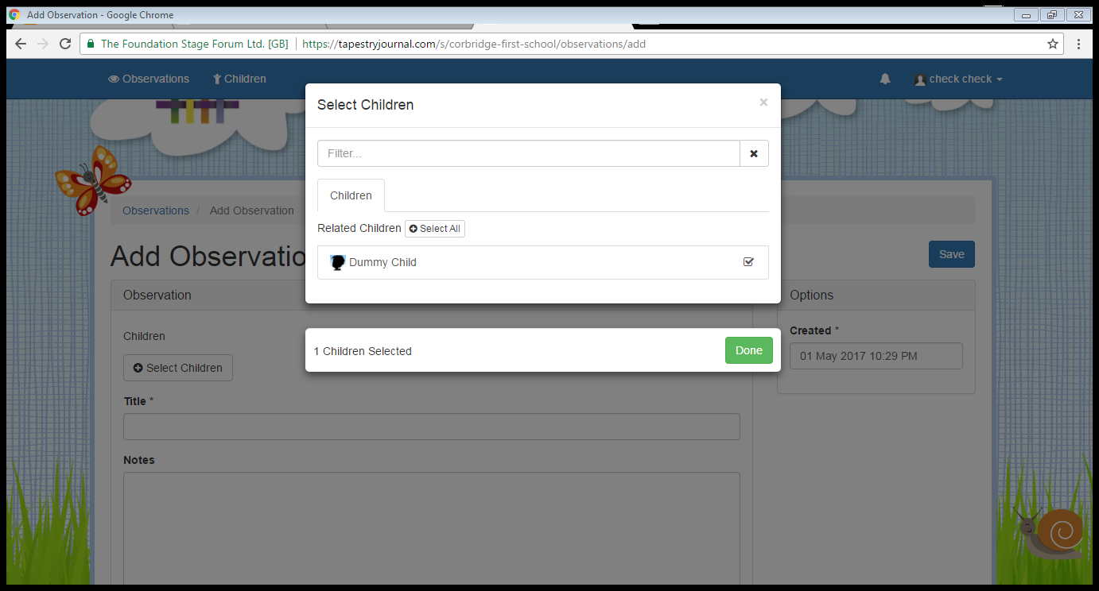
2. Next click on select children and add your child. Select done.

Slide 8
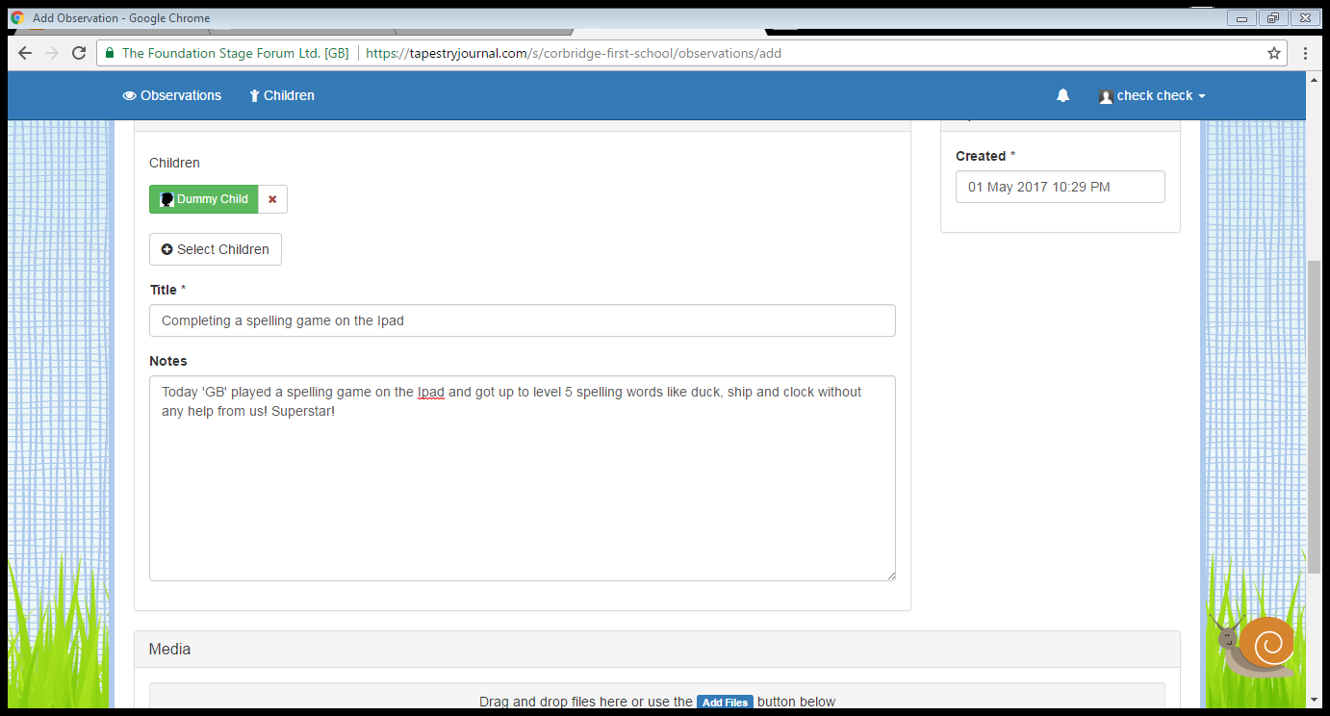
3. A short title must be added. Then write a short commentary of the activity you want to share.

Slide 9
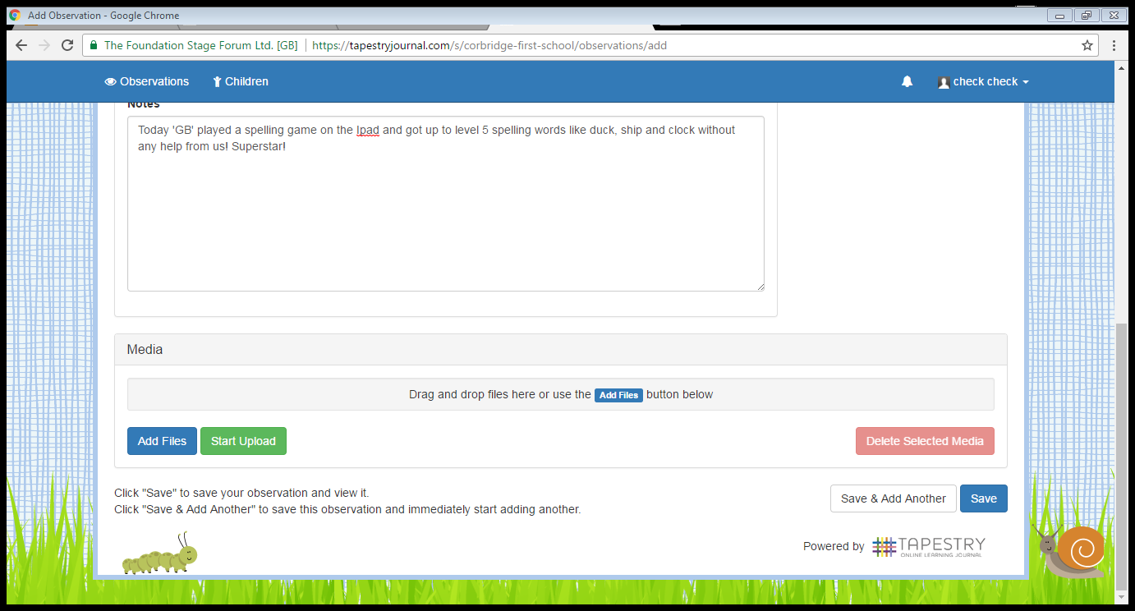
4. If you wish to add photos, select add files and then follow the on-screen instructions.
Once you are happy with your observation click save at the bottom right of the screen.

Slide 10
Adding observations
Staff will like the observation to acknowledge receipt
Staff will add observation to journal
Staff may attach an age-band refinement
Physical development – ie riding a bike, swimming, football, dance clubs, performances
Communication and language – bedtime stories,
Understanding the World/Personal and Social – celebrations, family life
If observations/photos include other children you MUST have their permission to upload – journals can be used for in school/local authority moderation
Where possible – observations will be shared with the whole class during show and tell activities.

