Slide 1
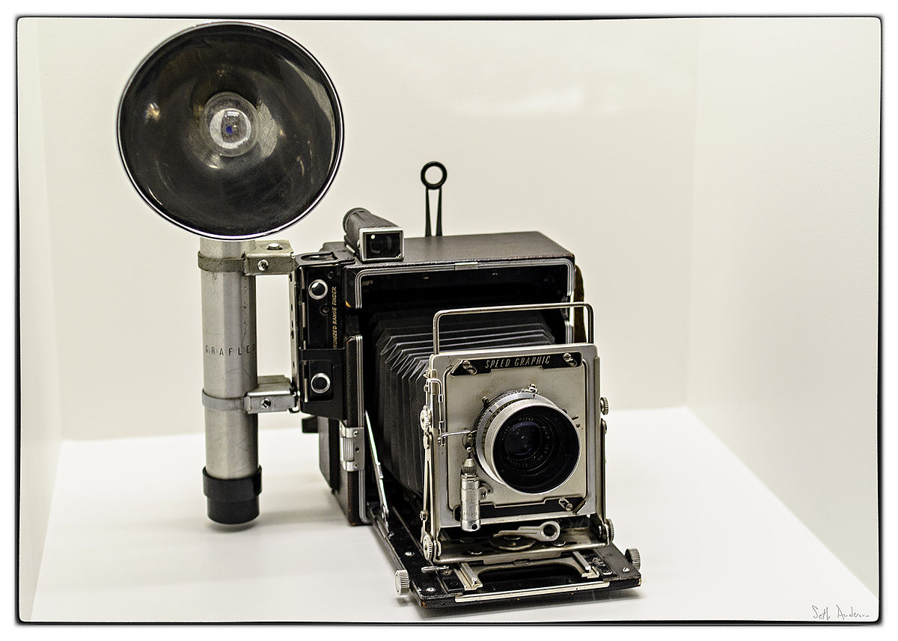
Old Technology
This Photo by Unknown Author is licensed under CC BY-SA

Slide 9
The End

