Slide 1
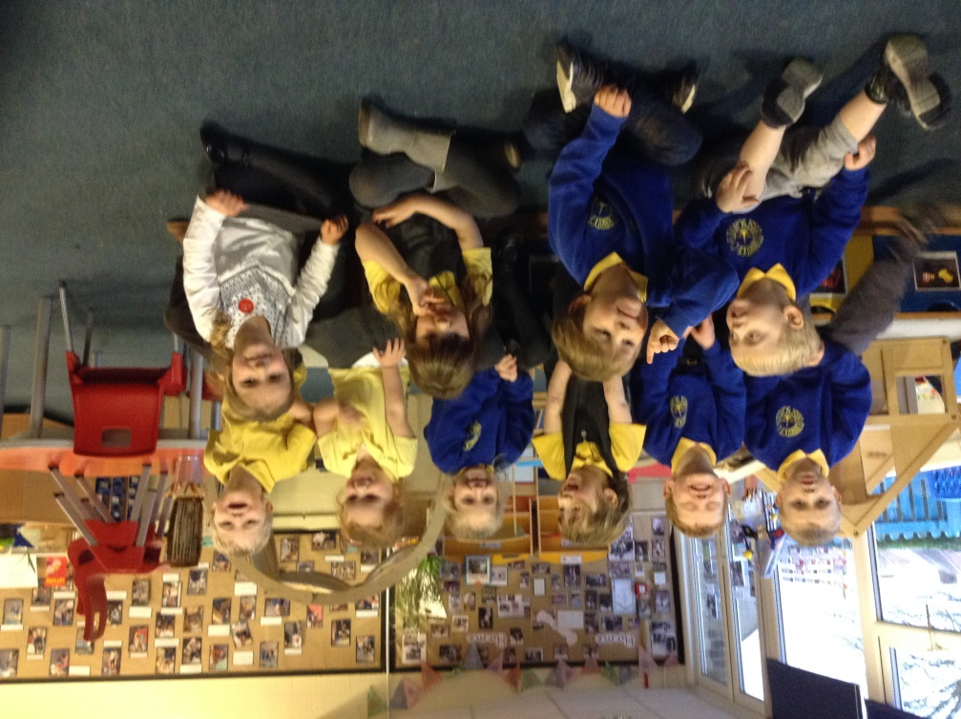
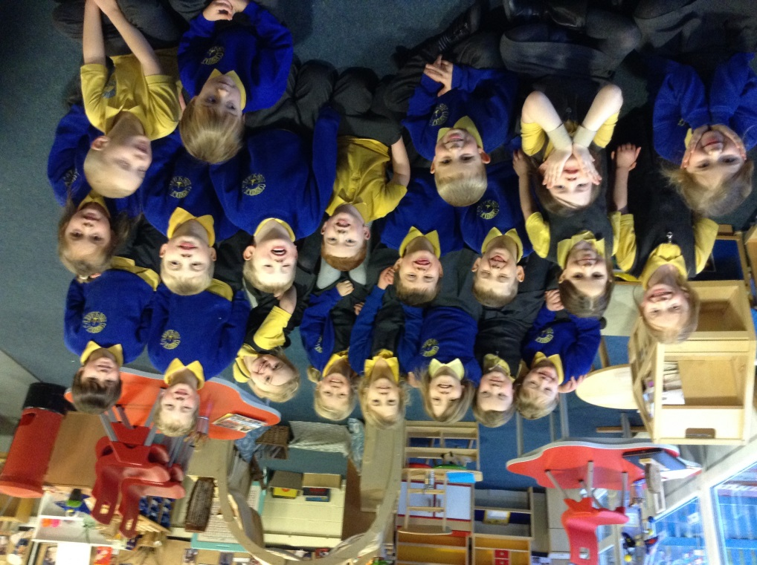
Teaching and Learning Phonics at Corbridge First School

Slide 2
Aims of the session:
To share how phonics is taught.
To develop your confidence in helping your children with phonics and reading
To teach the basics of phonics and some useful phonics terms
To outline the different stages in phonic development
To show examples of activities and resources we use to teach phonics
To give you an opportunity to ask questions

Slide 3
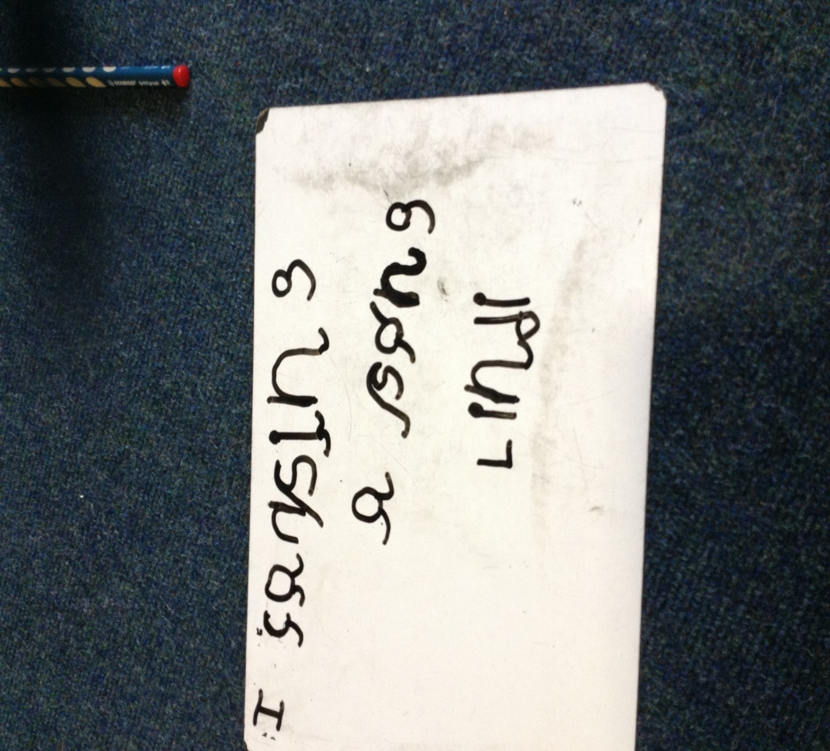
What is phonics?

Slide 4
Phonics is all about using …
skills for reading and spelling
knowledge of the alphabet
Learning phonics will help your child to become a good reader and writer.

Slide 5
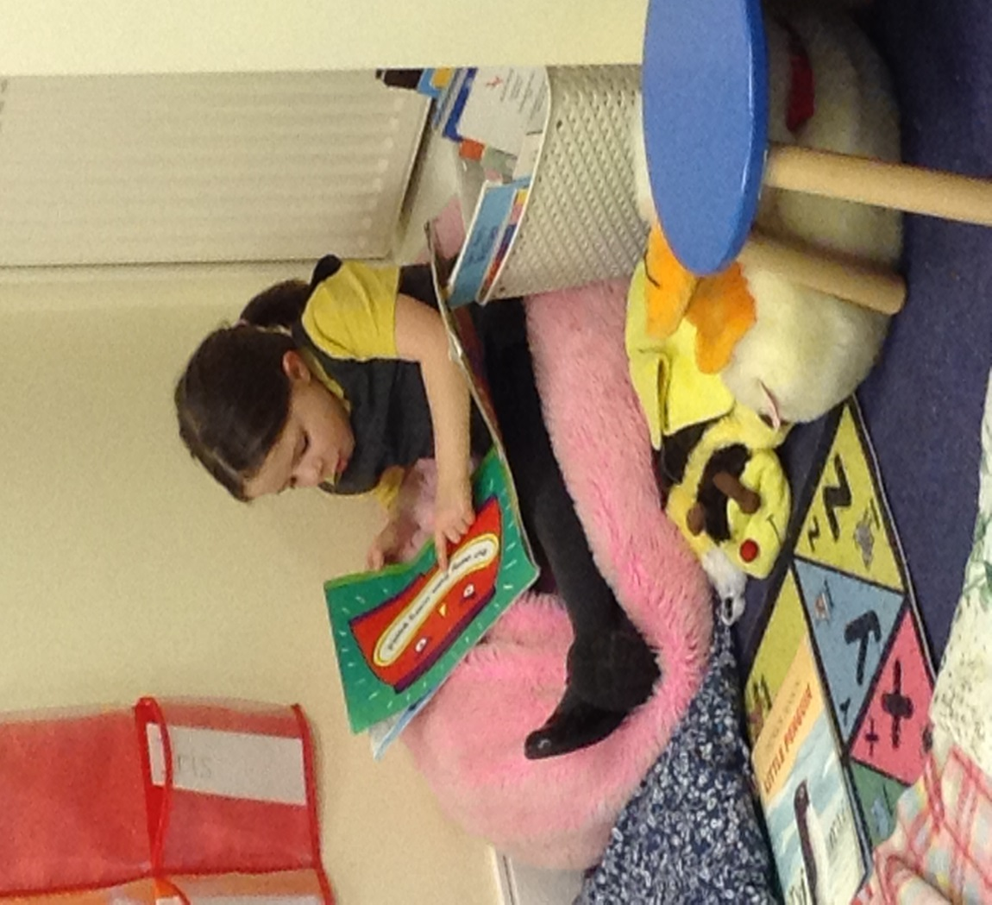
Every child in Nursery and Reception learns daily phonics at their level
Phonics gradually progresses to learning spellings – rules etc.

Slide 6
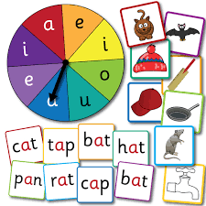
Every day the children have a RWI phonic session.
4 afternoons a week each Reception child takes part in Read, Write Inc reading sessions.
• Fast paced approach
Lessons encompass a range of games,
songs and rhymes
There are 3 phonics phases which the children work through.

Slide 7
Phonemes: The smallest units of sound that are found within a word, e.g. m.
Diagraph: Two letters that make one sound when read, e.g. sh
Trigraphs: Three letters that make one sound, e.g. igh.
CVC: Stands for consonant, vowel, consonant, e.g. c a t
Segmenting is breaking up a word into its sounds.
Blending : Putting the sounds together to read a word
Green Words- words that the children can sound out.
Red Words- these are tricky words that cannot easily be decoded, e.g.
‘the’ it can not be sounded out.
Sometimes Red Words are only red for a while until sounds are covered further in the sets, e.g. ‘yes’ as ‘y’ is not covered until the end of set 1.

Slide 8
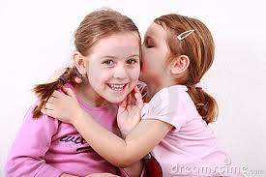
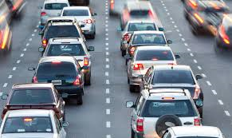
Phase 1: Getting ready for phonics
1. Tuning into sounds
2. Listening and remembering sounds
3. Talking about sounds
Music and movement
Rhythm and rhyme
Sound effects
Speaking and listening skills

Slide 9
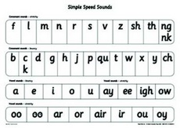
Phase 2: Learning phonemes to read and write simple words
We learn sounds in sets of phonemes.
Set 1
m a s d t i n p g o c k u b f e l h sh r j v y w
Th z ch qu x ng nk
Set 2
Ay ee igh ow oo oo ar or air ir ou oy
Set 3
ea oi a-e i-e o-e u-e aw are ur ou ai oa ou ow eu ire ear ure tion cious tious

Slide 10
CVC Words “consonant-vowel-consonant”
They will use these phonemes to read and spell simple (CVC) words:
sat, tap, dig, duck, rug, puff, hill, hiss
All these words contain 3 phonemes (sounds), although some may contain 4 letters.
d u ck
. .

Slide 11
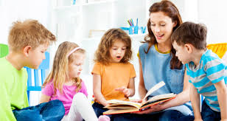
Saying the sounds
Sounds should be articulated clearly and precisely.
https://www.youtube.com/watch?v=5J2Ddf_0Om8

Slide 12
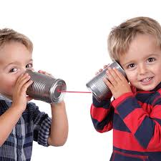
Phonic Words
Your children will learn to use the term:
Blending
Children need to be able to hear the separate sounds in a word and then blend them together to say the whole word .

Slide 13
/b/ /e/ /d/ = bed
/t/ /i//n/ = tin
/m/ /u/ /g/ = mug

Slide 14
Your children will learn to use the term:
Segmenting
Children need to be able to hear a
whole word and say every sound that
they hear .

Slide 15
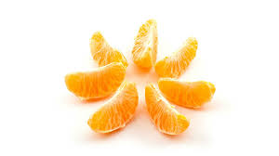
bed = /b/ /e/ /d/
tin= /t/ /i/ /n/
mug= /m/ /u/ /g/

Slide 16
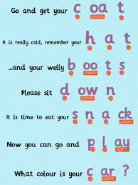
How can I help at home?
Oral blending: the robot game or Fred Talking
Children need to practise hearing a series of spoken sounds and merging them together to make a word.
For example, you say ‘b-u-s’, and your child says ‘bus’.
“What’s in the box?” is a great game for practising this skill. You can fill a box with various items, and then take turns to sound out and blend the item, e.g. I have a “s- o –ck”

Slide 17
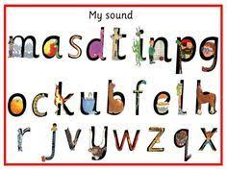
Your children will learn to use the term:
phoneme
Phonemes are sounds that can be heard in words
e.g. c-a-t
Your children will learn to use the term:
grapheme
This is how a phoneme is written down

Slide 18
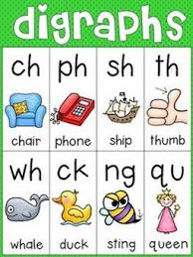
Your children will learn to use the term:
digraph
This means that the phoneme comprises of two letters
e.g. ll, ff, ck, ss

Slide 19
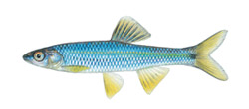
Phoneme frame and sound buttons
c | a | t
. . .
f | i | sh
. . _

Slide 20
log
duck
fill
l | o | g
. . .
d | u | ck
. . _
f | i | ll
. . _

Slide 21
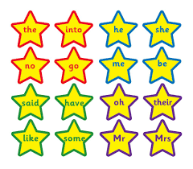
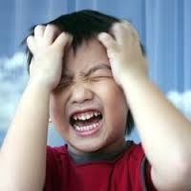
Tricky Words
There are many words that cannot be blended or segmented because they are irregular.

Slide 22
Learning the long vowel phonemes
Set 2
j, v, w, x, y, z, zz, qu
ch, sh, th, ng, ai, ee, igh, oa, oo, ar, or, ur, ow, oi, ear, air, ure, er
They will use these phonemes (and the ones from Set 1) to read and spell words:
chip, shop, thin, ring, pain, feet, night,
boat, boot, look, farm, fork, burn,
town, coin, dear, fair, sure

Slide 23
Your children will learn to use the term:
Trigraph
This means that the phoneme
comprises of three letters
e.g. igh , ear, ure

Slide 24
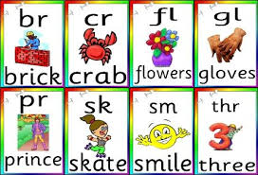
Introducing consonant clusters: reading and spelling words with four or more phonemes
When children know all the phonemes from Set 2 and 3 and can use them to read and spell simple words (blending to read and segmenting to spell), they will then move on to consonant clusters.
.
Here we focus on reading and spelling longer words with the phonemes they already know.
These words have consonant clusters at the beginning: spot, trip, clap, green, clown
…or at the end: tent, mend, damp, burnt
…or at the beginning and end! trust, spend,
twist

Slide 25
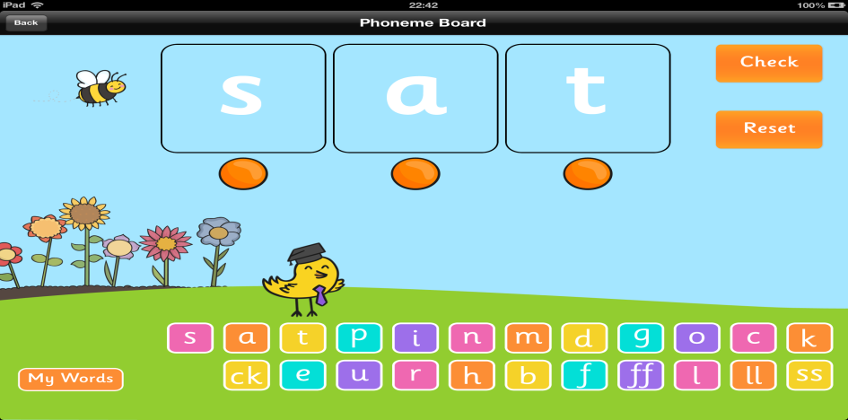
Is there anything I can do at home?
y | e | s
* Phonic Eye Spy:” I spy with my little eye, something beginning with… t.”
This can then move on to include blending, “I Spy with my little eye, a d o g.”
Pointing out sounds in the environment, e.g. street signs, menus, book titles etc.
Online activities and apps
*Hairy Letters
*Pocket Phonics
Ladybird app (check it is the English version and not US)
Geraldine Giraffe from Mr Throrne’ does phonics
Reading Eggs

