Slide 2
The Letter N Looks Like This…
N
Click on the pencil to see the letter formation.
Can you draw it with your finger?

Slide 3
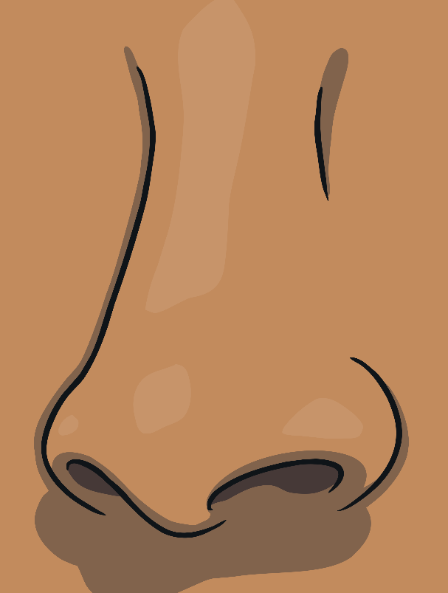
The Letter N Sounds Like This…
N, N, N
Teaching note: Say the sound /n/ and have children repeat it back multiple times

Slide 4
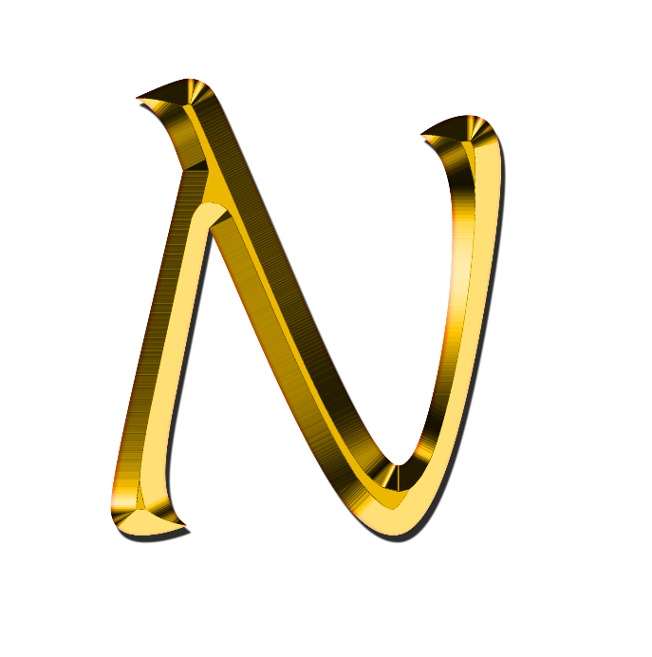
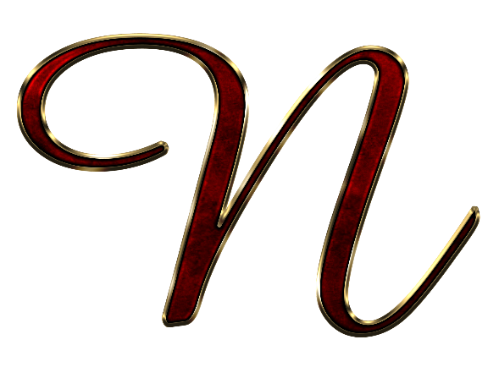
It Can Also Look Like This…

Slide 5
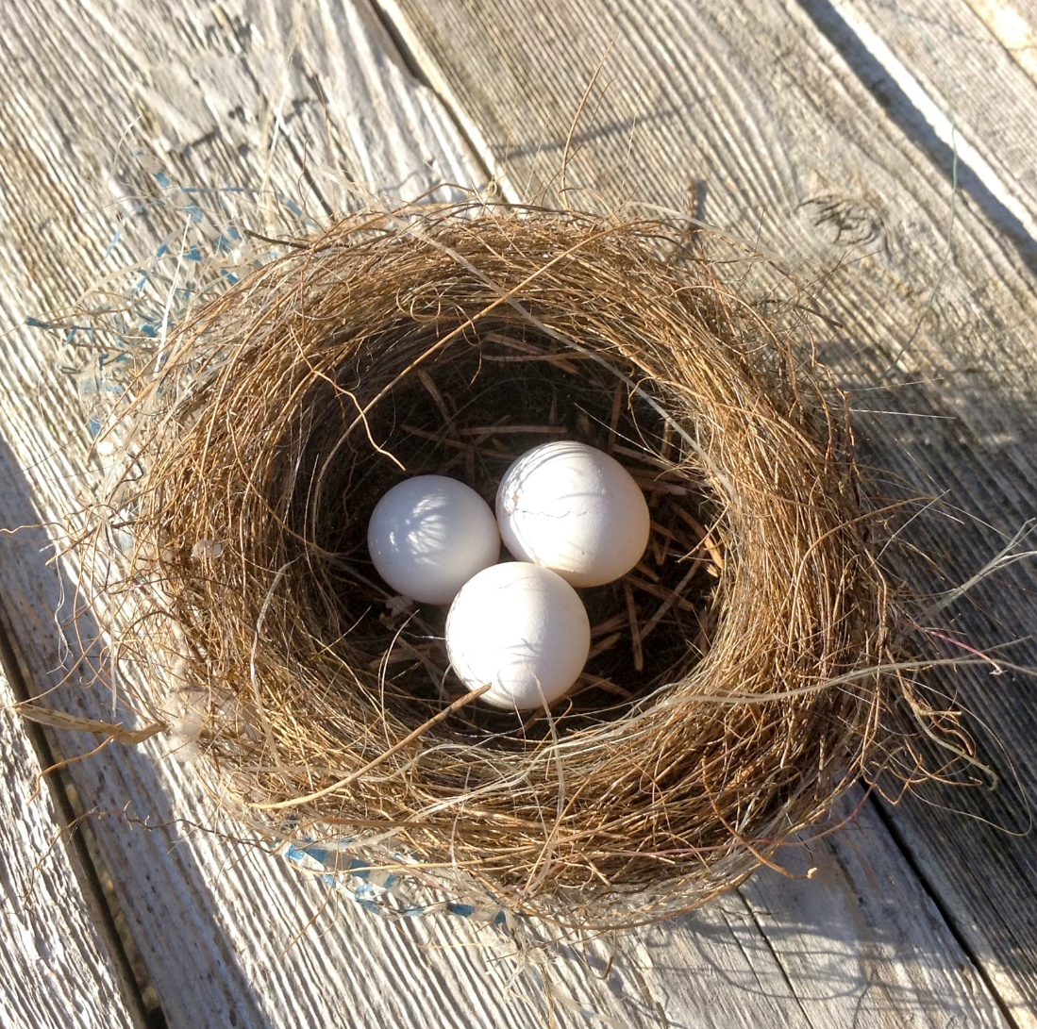
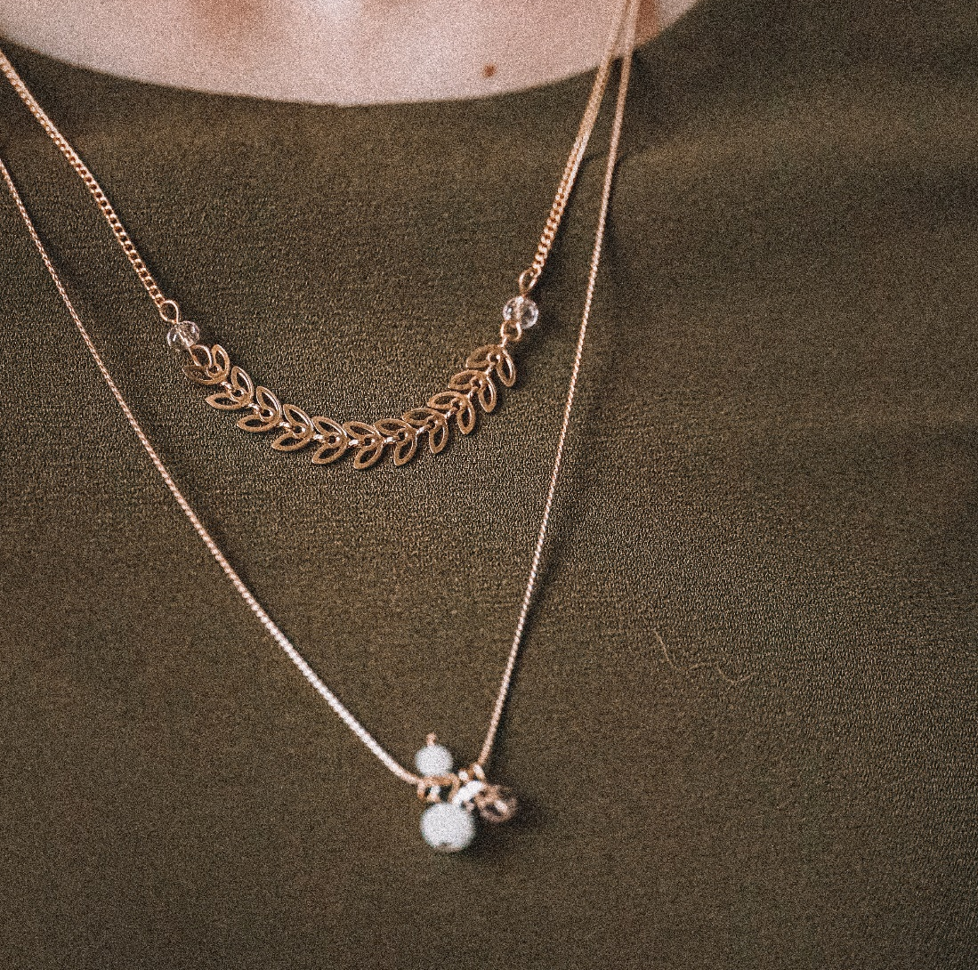
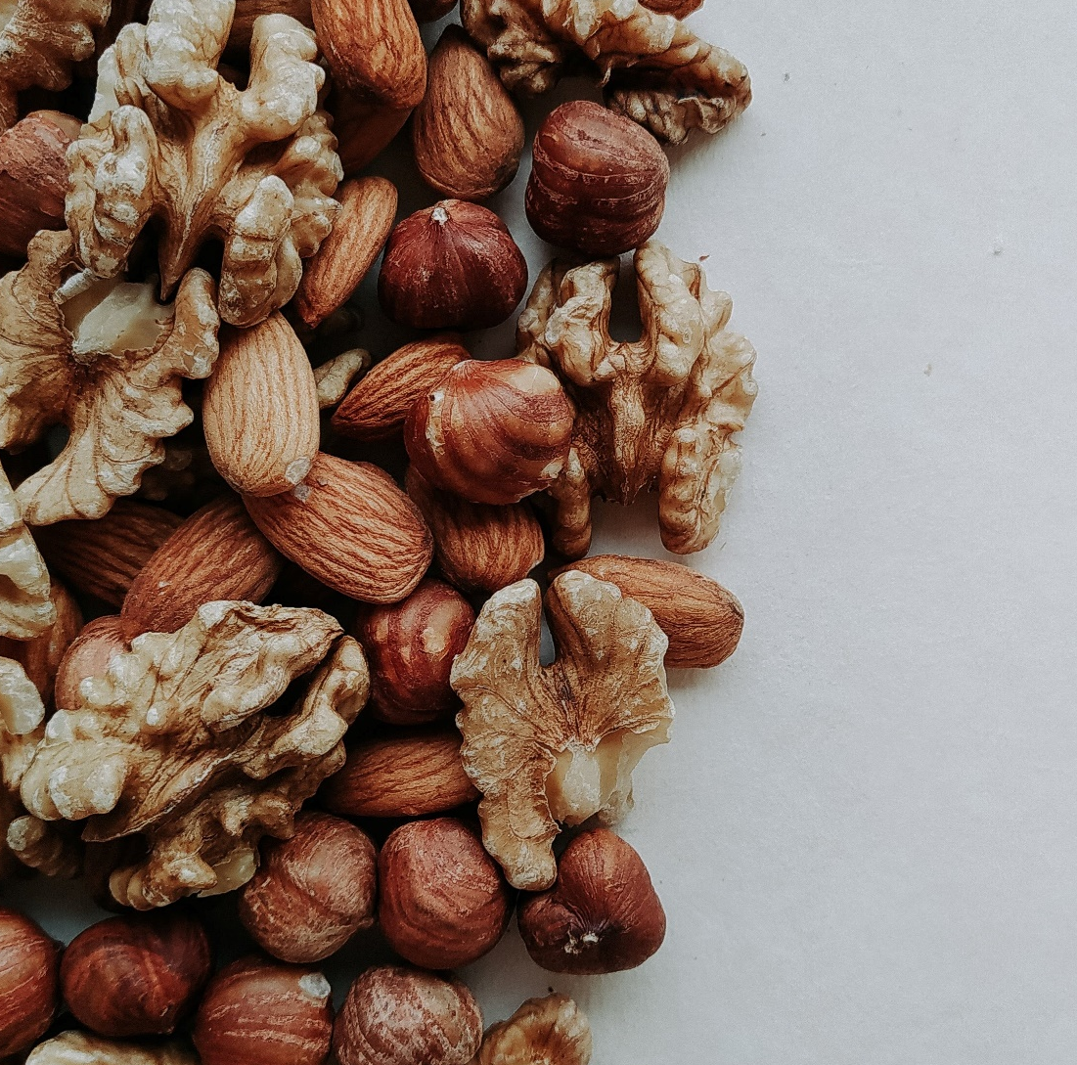
Some Things That Start With N Are…

Slide 6
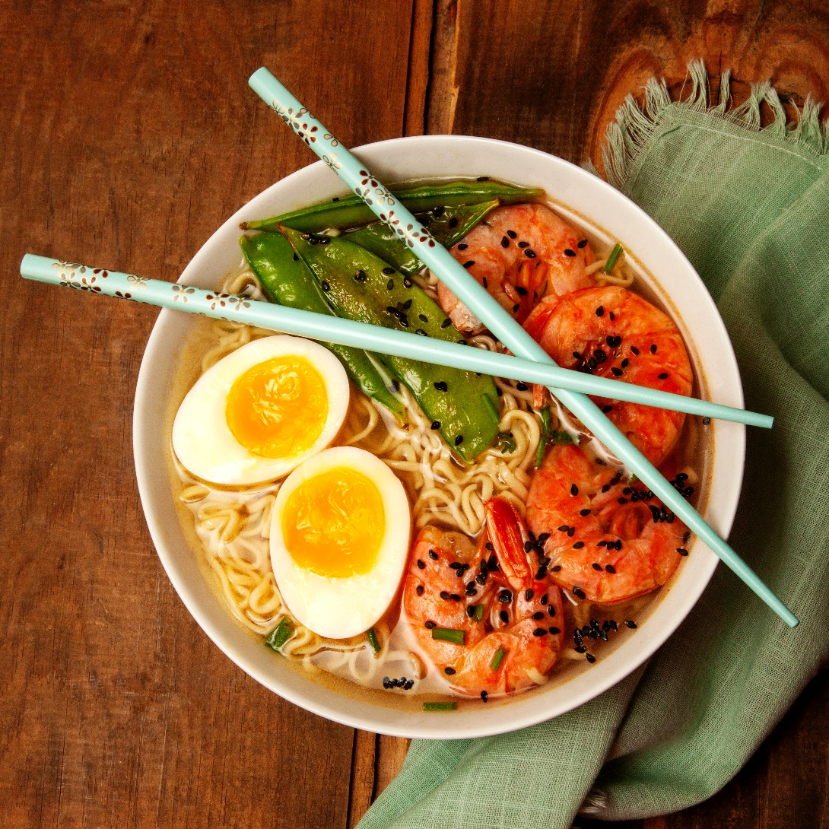
Some Things That Start With N Are…

Slide 7
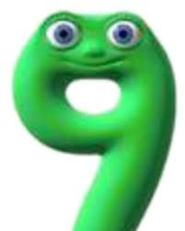
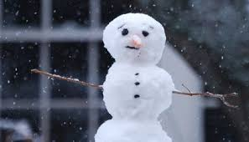
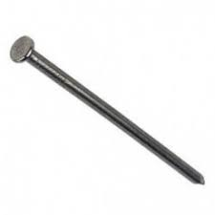
Which of these things begin with the ‘n’ sound?

