Slide 1
Set 1 Sounds
Read Write Inc

Slide 2
These are the sounds for Week 2 and Week 3 The sounds must be pronounced clearly without the ‘uh’ at the end, e.g. ‘t’ not ‘tuh.’ The formation rhyme is below each phoneme (sound.)

Slide 3
Down Maisie, mountain, mountain.

Slide 4
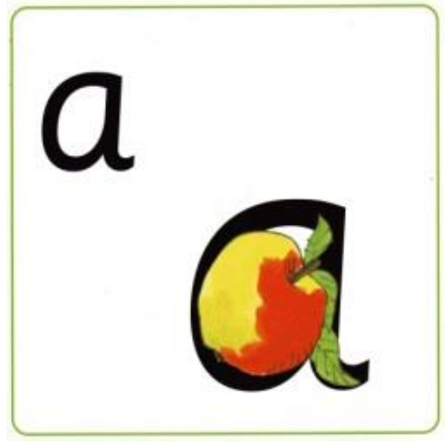
Around the apple and down the leaf.

Slide 5
Slither down the snake.

Slide 6
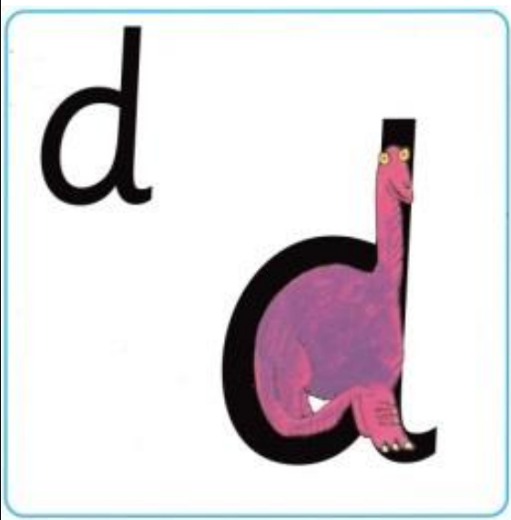
Around the dinosaurs bottom, up his tall neck and down to his toes.

Slide 7
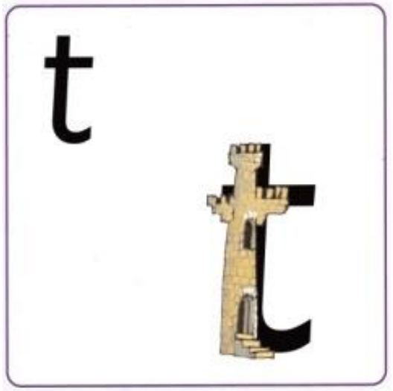
Down the tower, across the tower.

Slide 8
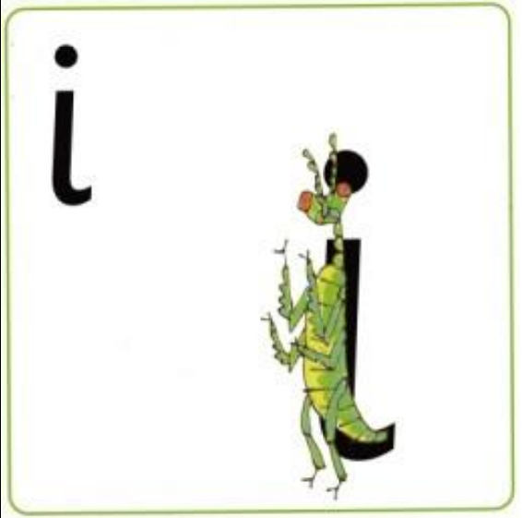
Down the body and dot for the head.

Slide 9
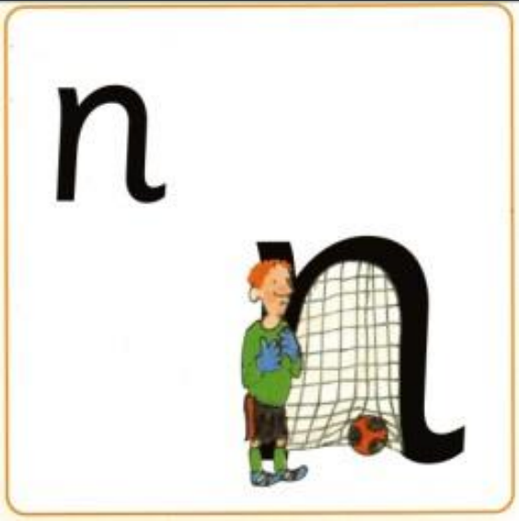
Down Nobby and over his net.

Slide 10
Down the pirates plait and around his face.

Slide 11
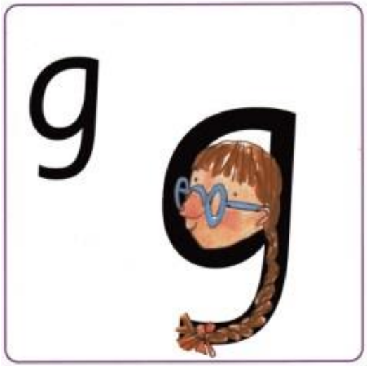
Around the girls face, down her hair and give her a curl.

