Slide 1
The Gospel
Good News: God likes to give good things in answer to prayers
Luke 11:9-13

Slide 2
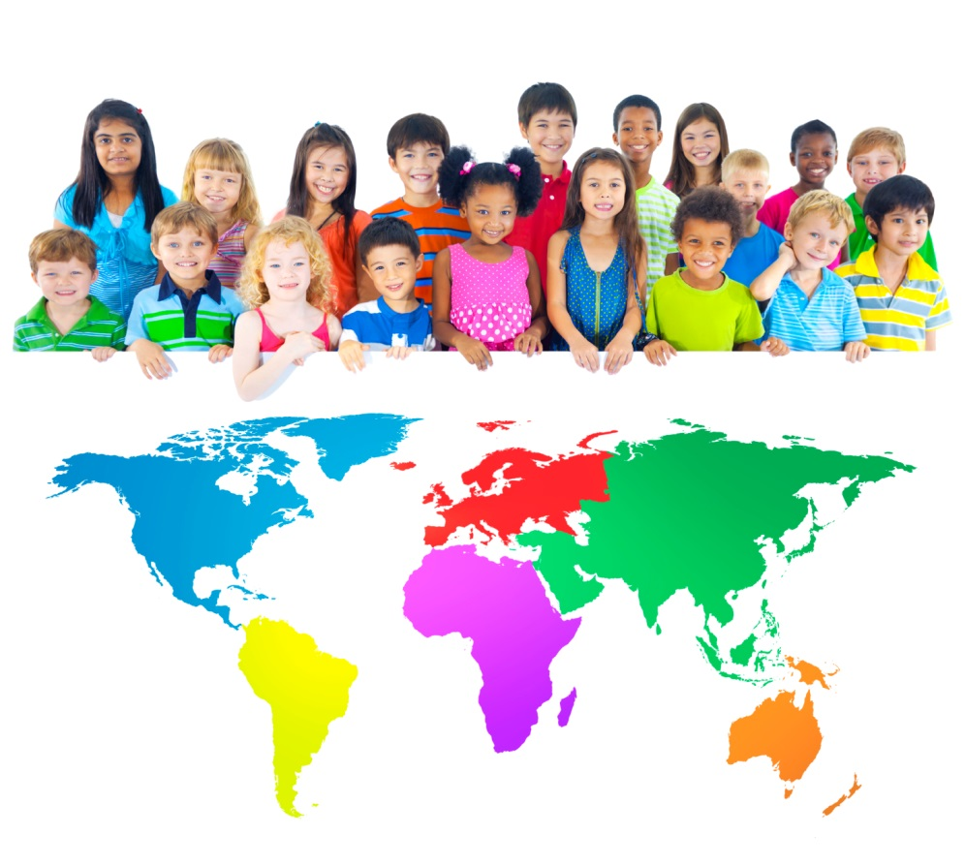
Can you make a list of all the things mums and dads, or other carers, do to show they love their children?
This Photo by Unknown Author is licensed under CC BY-NC
This Photo by Unknown Author is licensed under CC BY-NC-ND

Slide 3
Can you decide which order these ten gifts that God gave Christian’s should go in? Which is the best?
Animals to care for
Imagination
Life
The Earth
Love
Beautiful days
Food
Water
Our brains
Each other

Slide 4
God is like a parent | God is unlike a parent

Slide 5
The Lord’s prayer
‘Our Father in heaven … ‘

