Slide 1
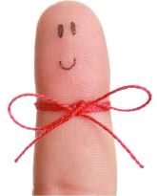
We are all connected
Introduction: We Are All Connected
www.knowsleyclcs.org.uk
Year 1
Really want to see those fingers!
Knowsley City Learning Centres
@knowsleyclcs

Slide 2
Introduction: We Are All Connected
What is the Internet?

Slide 3
Introduction: We Are All Connected
These computers are all linked together, and they can "talk" to each other, sharing information.
If your computer is connected to the Internet, it can connect to millions of other computers, in many different parts of the world.
The Internet is a huge collection of computers around the world.

Slide 4
Introduction: We Are All Connected
What can you do on the Internet?
* You can send electronic letters to people, these are called emails.
* You can read pages on the World Wide Web.
* You can play games with people on the other side of the world.
* You can chat to people.
* You can even buy things on the Internet and have them delivered to your house!

Slide 5
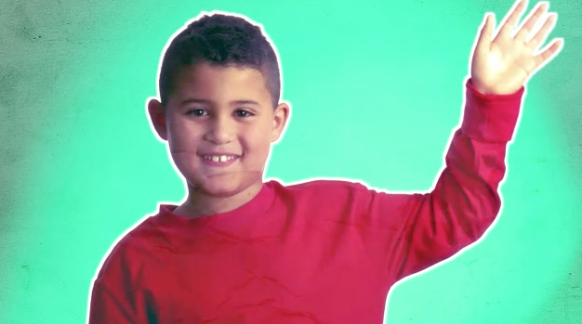
Introduction: We Are All Connected
Watch My Neighbourhood Video in Resources

