Slide 1
The Pearl of Great Price

Slide 2
Look at the pictures on the next page.
Talk about what you think the most valuable item is and why?

Slide 3
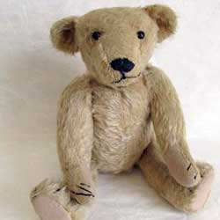
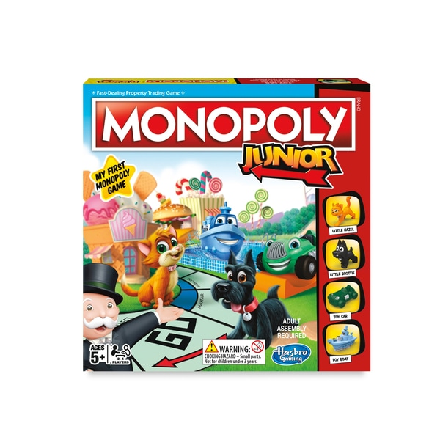
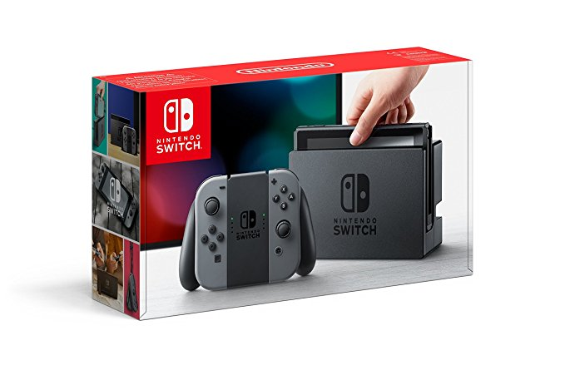

Slide 4
The Pearl of Great Price
https://www.youtube.com/watch?v=gDDTDtB3eBU

Slide 6
The kingdom of heaven is like a merchant man, one who bought and sold things, and was seeking or trying to find pearls of good quality. Finally, he found a good, beautiful pearl, but it was very expensive. Do you know what the merchant man did? He went and sold everything he had and, then, went back and bought that valuable pearl.

Slide 7
Christians think of God as the One who matters most, but anyone can get distracted from what they most care about by little things.

Slide 8
Jesus said:
“…The kingdom of heaven is like what happens when a merchant is looking for fine pearls. After finding a very valuable one, the merchant goes and sells everything he owns in order to buy that pearl.”

Slide 9
….Jesus said that you are like that pearl…
…you are God’s most valuable possession…..

Slide 10
Draw symbols of three things that matter most to you inside the oyster shell.
Can you describe which of your symbols is the most important? Why?

Slide 11
Dear God
Thank you for Jesus who told such great stories! Thank you for this parable of the pearl of great price, a story that reminds us that we are all so valuable to you. Help us to value each other as though we were precious treasure.
Amen

