Slide 1
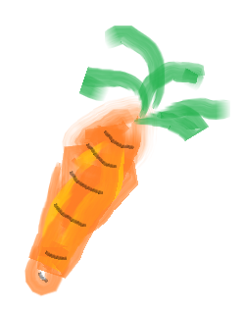
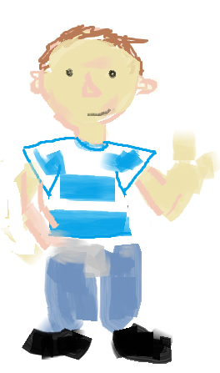
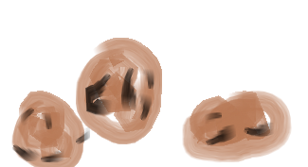
Oliver's Vegetables

Slide 2
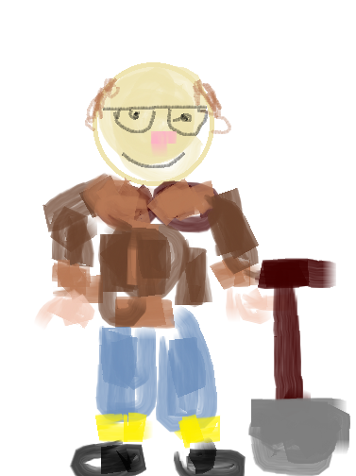
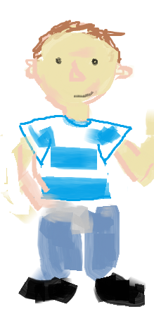
Oliver went to visit his Grandpa
Grandpa was very proud of his Vegetables that he grew in his garden

Slide 3
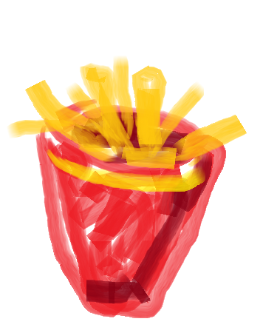
But Oliver only ate Chips!

Slide 4
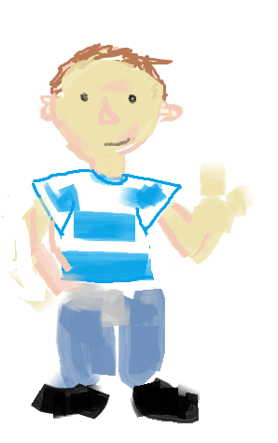
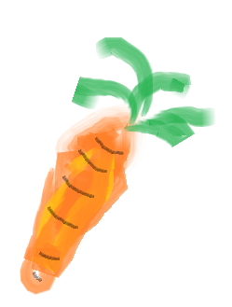
But.... on Monday Oliver tried some Carrots
Very Good!

Slide 5
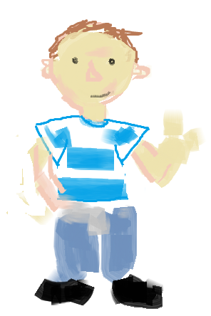
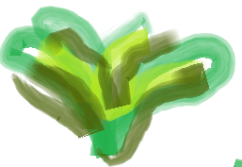
On Tuesday he tried some Spinach
Very Good!

Slide 6
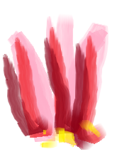
On Wednesday he tried some Rhubarb
Very Good!

Slide 7
And on Thursday he tried some Cabbage
Very Good!

Slide 8
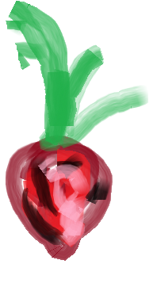
On Friday he tried Beetroot
Very Good!

Slide 9
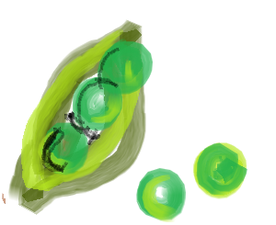
And on Saturday he tried peas
Very Good!

Slide 10
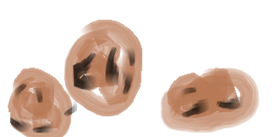
Finally, on Sunday he found the Potatoes.....

Slide 11
... And he had Chips!

