Slide 1
Year 3 - Summer - Block 3
Properties of Shape

Slide 2
The arrow on a spinner
started in this position.
Jack says,
Alex says,
Who do you agree with?
After making a turn it ended in this position.
The arrow has moved a quarter turn
anti-clockwise.
The arrow has moved a three-quarter turn clockwise.

Slide 3
The letter ‘X’ has four angles.
Write your name in capital letters.
How many angles can you see in each letter? How many angles are there in your full name?
X

Slide 4
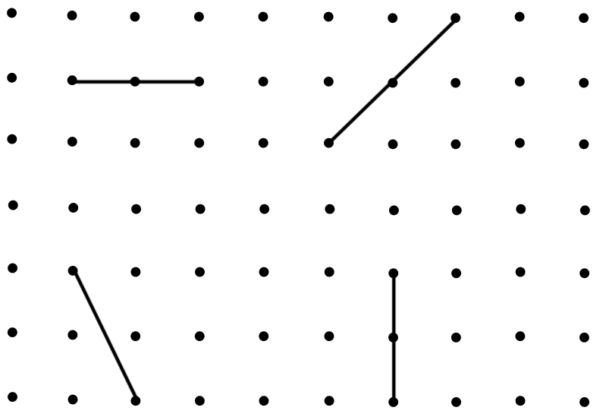
Draw a line along the dots to make a right-angle with each of these lines:

Slide 5
True or False?
This shape has two right-angles.
Explain your answer.

Slide 6
How many right angles can you see in this image?
Can you create your own image with the same number of right angles?

Slide 7
Label the acute angles (A) and obtuse angles (O) on the diagram below

Slide 8
Teddy describes a shape.
What could Jack’s shape look like?
Describe a shape in terms of it’s angles for a friend to draw.
My shape has 3 right angles and 2 obtuse angles.

Slide 9
Alex measures the line.
She says it is 10 cm 4 mm
Is Alex correct?
Explain why.

Slide 10
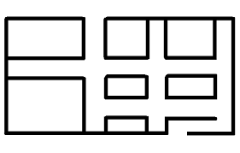
Use straight lines to show the route the car could take to get out of the maze.
Work out the length of the route to the nearest cm
Is this the shortest route?

Slide 11
Eva completes the table by drawing shapes.
Can you spot and correct her mistake?
Horizontal line of symmetry | Vertical line of symmetry | Horizontal and vertical lines of symmetry

Slide 12
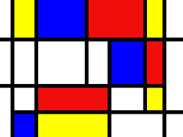
How many horizontal and vertical lines can you spot in this image by Mondrian?
Create your own piece of art work using only horizontal and vertical lines.

Slide 13
True or False?
A B
C D
Line AB is parallel to line CD.
Line AC is parallel to line BD.
Line AC is perpendicular to line CD.
Redraw the shape so that line BD is perpendicular to line CD.

Slide 14
These lines are NOT parallel.
Convince me.

Slide 15
Mark 3 sets of parallel lines and 3 sets of perpendicular lines in this flag.
Design your own flag containing parallel and perpendicular lines.

Slide 16
Rosie describes a 2-D shape.
Draw the shape that Rosie is describing.
Could this square be Rosie’s shape?
Explain why.
My shape has 2 pairs of parallel sides. The lengths of the sides are not all equal.

Slide 17
What is the same and what is different about these shapes?

Slide 18
Draw at least one shape in each section of the diagram.
 | At least one right angle | No right angles
4 sided
Not 4 sided

Slide 19
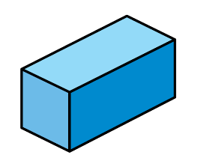
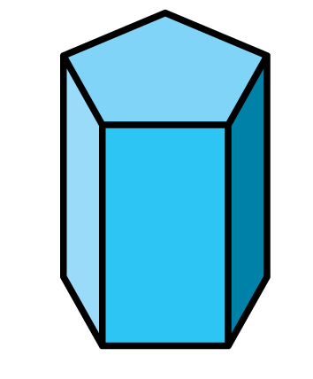
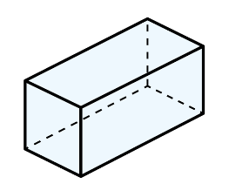
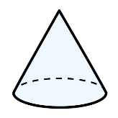
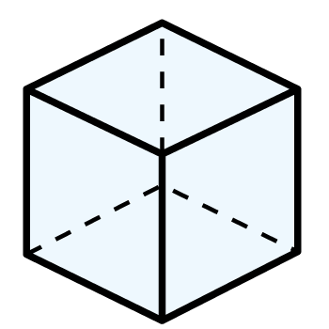
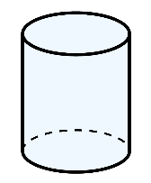
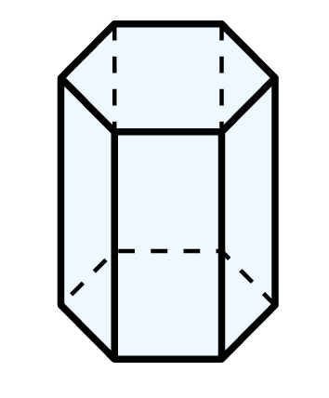
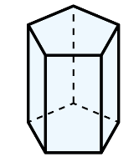
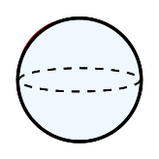
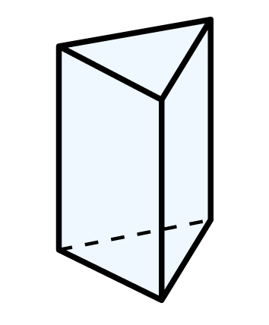
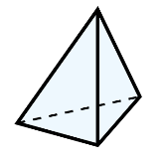
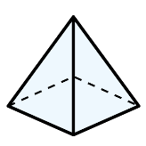
Mo has a 3-D shape, he says,
What could Mo’s shape be?
One face of my 3-D shape is a square.

Slide 20
Alex says,
Do you agree with Alex?
Explain why
All 3-D shapes are prisms.

Slide 21
Sort a selection of 3-D shapes using the criteria in the table.
Change the headings of the table and re-sort your shapes.
 | At least one triangular face | No triangular faces
Prism
Not a prism

Slide 22
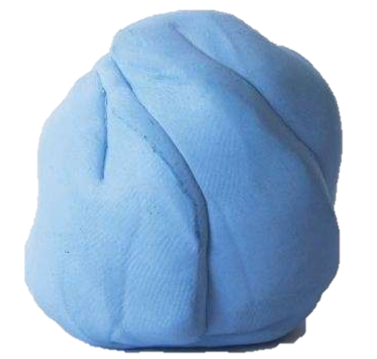
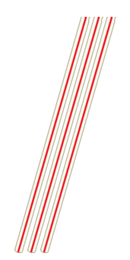
I have 9 straws and 6 balls of Play-Doh.
What 3-D shape can I create using all of the straws and Play-Doh?
Have a go at making it.

Slide 23
True or false?
You can cut out lots of equal squares and make a 3-D shape from them.
You can cut out some circles and rectangles and make a 3-D shape from them.

Slide 24
Rosie says,
Explain the mistake Rosie has made.
How many straws and balls of Play-Doh would you need to create a pyramid?
I can create a model of a square-based pyramid using 3 straws and 3 balls of Play-Doh.

